Slide 1
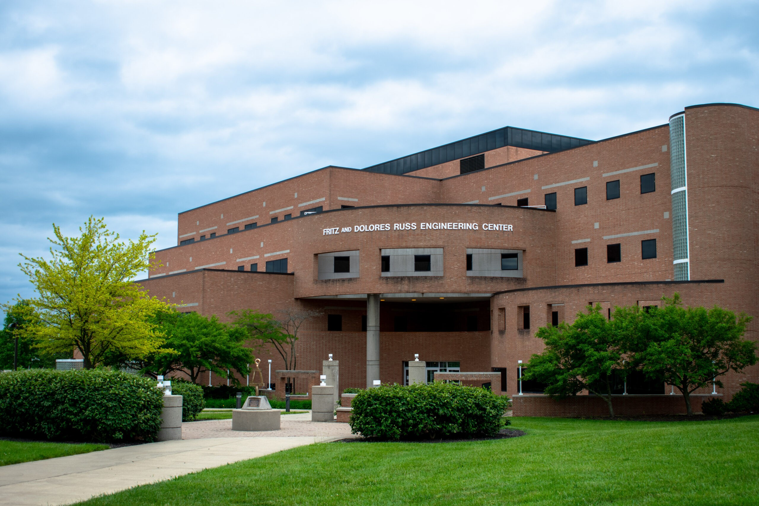
CS 4850 Final Project The Elevators of Russ
By Matthew Slusser

Slide 2
Question
Why are the elevators in the Russ Engineering building so awful?
Could the elevators use to a different scheduling strategy and reduce the average wait time?

Slide 3
System
I’m sure we’re all familiar with the iconically slow elevators of the Fritz and Delores Russ Engineering building, such is the case that we are talking about a simulation of those sluggish lifts.
For those less familiar, the Russ Engineering Center at Wright State has two elevators in the lobby of the building. These elevators, by default, idle at the floor that they last stopped on until called again to pickup the next rider. My goal is to see if a different idle configuration might decrease the average wait time.

Slide 4
System – Tested configuration Methods
I looked at three alternate configurations for the elevator's idle operation:
Idle One – In this configuration the elevator will always return to the first floor if it does not have anyone queued.
Sequential – In this configuration the two elevators always move in opposed directions, elevator one moves up while elevator two moves down. Additionally, if elevator one brings someone to the third or fourth floor, it will return to the first floor if the queue is empty. If elevator two brings someone down to the first or second floor, it will return to the fourth floor if the queue is empty.
One-Four – In this configuration the elevators have no directional preference but, if elevator one has no queue it will always return to the first floor and if elevator two has no queue it will return to the fourth floor.

Slide 5
System - Assumptions
In making this simulation I had to make several assumptions of the world:
Some primary assumptions that I made are that the travel time between floors is uniformly within a range of 9.5-10.5 or 1 seconds and the time that it takes for the doors to open or close is uniformly within a range of 3.8 to 5.3 or 1.5 seconds.
I also figured that because we are looking at wait time and not throughput, interarrival time would not matter all too much. So, I estimated that someone would arrive on a floor at a random exponentially distributed time with a mean 35 seconds. I felt like this rate was enough to saturate elevator usage so that people would have to wait but not so much that the elevators could never idle. Ideally, I would’ve gotten real world data from each floor to reflect the true system better, but, due to how limited my schedule was to collect data I felt this was adequate.

Slide 6
System - Assumptions
Another set of assumptions I had to make was the distribution of what floors people started on and went to. This was a datapoint that I didn’t feel was feasible to collect without something or someone to watch the floor selector panel and current floor display inside the elevator. Instead of collecting real data, I estimated it from my observed experience over the past 4 years. (estimations found to the right)
No one bawks. Additionally, each arrival is considered a batch arrival. This means that each time a new “rider” is generated, it is treated the same as if someone in the real system pressed the call button and if more people do or don’t show up it is not called again till that batch has left. Part of this effect comes from “riders” being generated on a system level then assigned a floor, and not on a per floor basis.
5% of people start in basement or the maintenance level, 40% start on the first floor, 15% start on the second floor, 27% start on the third, lastly 13% start on the fourth floor.
5% of people go to the basement or maintenance level, 45% end on the first floor, 15% end on the second floor, 25% end on the third floor, finally 10% end on the fourth floor.

Slide 7
Results
I ran each simulation for 7200 time-units or 2 hours, with 1000 replicates.
Results w/ a mean Interarrival Rate of 35 (s) | Average Number of Riders / Hour | Mean of Mean Wait Times (seconds) | Mean of All Wait Times (seconds) | Variance of All Wait Times
Default | 102.5 | 35.81 | 36.12 | 50.73
Idle-One | 102.7 | 48.78 | 49.27 | 139.11
Sequential | 103.0 | 81.27 | 82.19 | 590.97
One-Four | 102.8 | 40.94 | 41.28 | 56.31

Slide 8
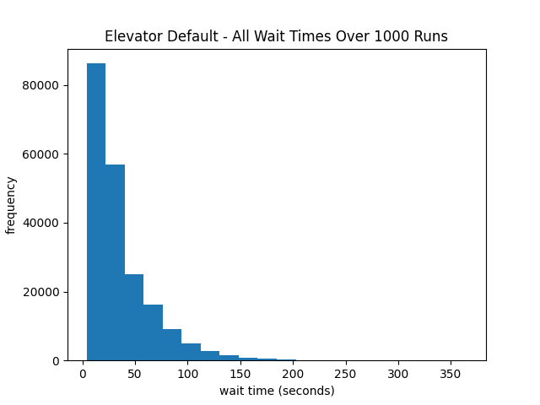
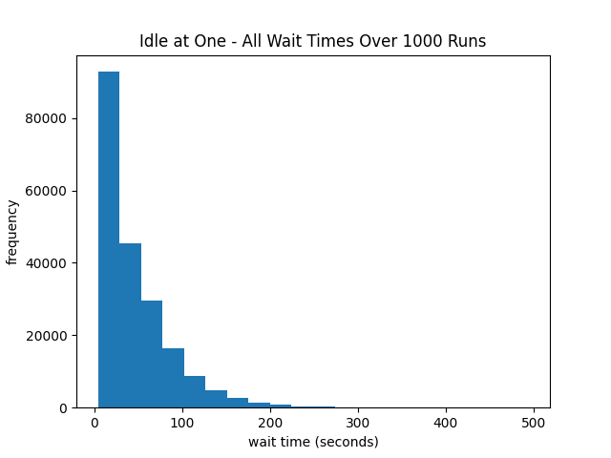
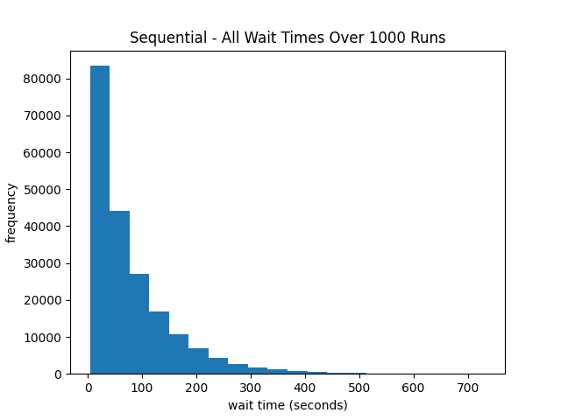
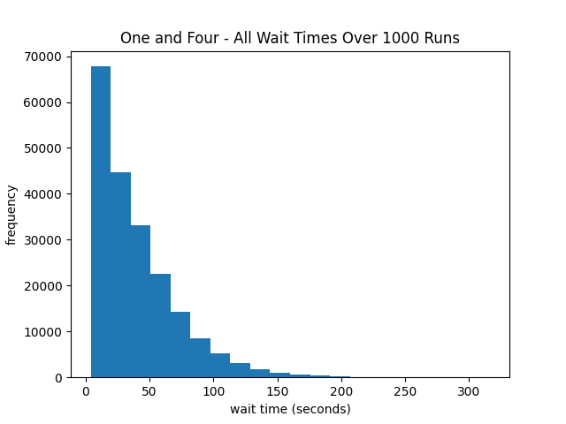
Results
All of them have clear exponential distributions
Histogram Bins: 20 bins
Mean Interarrival Rate: 35 seconds

Slide 9
Results – change in Interarrival Rate
Results w/ a mean Interarrival Rate of 25 (s) | Average Number of Riders / Hour | Mean of Mean Wait Times (seconds) | Mean of All Wait Times (seconds) | Variance of All Wait Times
Default | 144.4 | 106.92 | 108.69 | 2,721.83
Idle-One | 144.0 | 220.48 | 223.00 | 15,614.38
Sequential | 144.0 | 318.89 | 321.03 | 15,284.13
One-Four | 144.0 | 112.19 | 113.98 | 2864.60
I decided that although I wasn’t interested in the interarrival rate of the system to run my simulation with two additional variations on the interarrival rate to confirm my thinking that its impact was negligible
Results w/ a mean Interarrival Rate of 45 (s) | Average Number of Riders / Hour | Mean of Mean Wait Times (seconds) | Mean of All Wait Times (seconds) | Variance of All Wait Times
Default | 79.9 | 25.83 | 25.98 | 13.82
Idle-One | 79.8 | 31.92 | 32.15 | 25.39
Sequential | 80.0 | 48.69 | 49.14 | 107.73
One-Four | 79.8 | 29.80 | 29.98 | 17.11

Slide 10
Results
Interestingly I didn’t find that any idle configuration that was more efficient than the default. I suspect that part of this is due to a bias that I introduced through my estimated starting floor and ending floor distributions. I would be interest to see how this might change with a distribution based on real data or if it was distributed evenly across all floors.
I decided that although I wasn’t interested in the interarrival rate of the system to run my simulation with two additional variations on the interarrival rate to confirm my thinking that its impact was negligible

